Slide 1
Successful GAMEs during 2019 - 2024
BY ATHUL K M
MSC GT

Slide 2
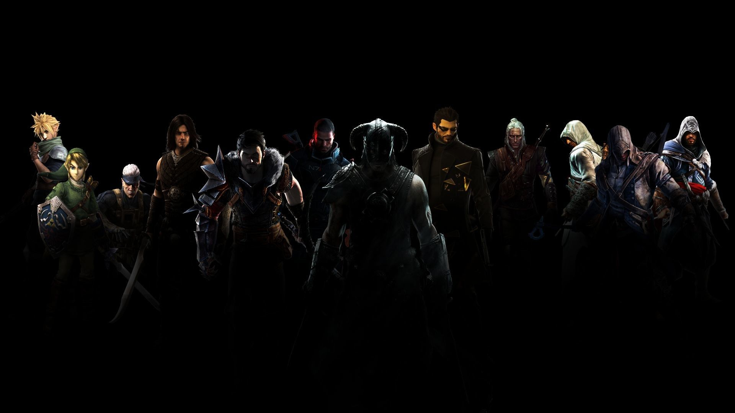
ABOUT game genres
A video game genre is a specific category of games related by similar gameplay characteristics. Video game genres are not usually defined by the setting or story of the game or its medium of play, but by the way the player interacts with the game.

Slide 3
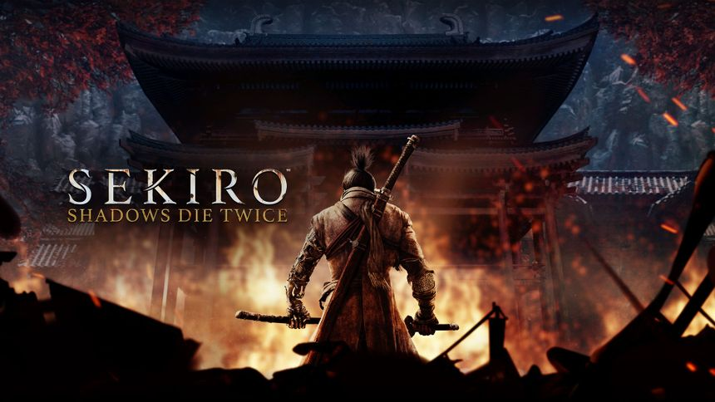
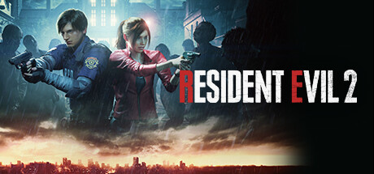
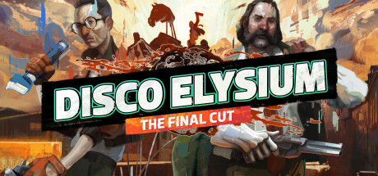
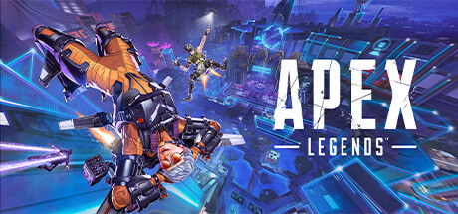

2019
In 2019, the PC gaming world saw several major releases across genres, many of which became widely popular and influential. Some of the top PC games of 2019 were a mix of AAA titles and some remarkable indie games. Here’s a look at some of the most successful PC games of that year:

Slide 4

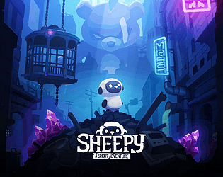
2d platformers
Developer: Studio MDHR Other Works: Cuphead: The Delicious Last Course (2022)
Developer: MrSuicideSheep
The game follows its teacup-headed character and his brother Mugman, as they make a deal with the Devil to pay casino losses by repossessing the souls of runaway debtors. The game is set in a 2d Slide-Scolling Perspective, Run and Gun Gameplay,Platforming Elements and in a Vintage Animation Style brings the game under 2d platformer genre
A short, handcrafted, fully independent pixel art platformer, spanning several zones with unique skills to unlock to discover an abandoned world full of secret. The game is set in a 2d Perspective,Platforming Elements and 2D art style suits platforming because it allows simple brings the game under 2d platformer genre

Slide 5
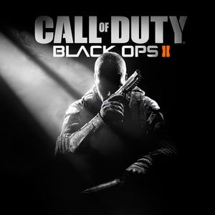
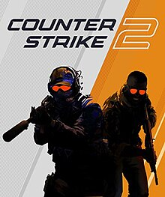
Shooter games
Shooter games are a genre of video games that emphasize gun-based combat. Players typically take on the role of a character who uses firearms or other ranged weapons to defeat enemies. Shooter games can be further divided into different genres:
Key Features:
Gunplay: The core mechanic involves aiming and shooting at targets, often requiring precision and quick reflexes.
Variety of Weapons: Players can usually choose from a range of firearms and explosives, each with different attributes and effects.
Multiplayer Options: Many shooter games offer online or local multiplayer modes, allowing players to compete against each other.
Level Design: Environments often include open areas for exploration and tactical gameplay, as well as confined spaces for close-quarters combat.

Slide 6
SHOOTer games
Developer: Treyarch Other Works: Call of Duty(Game series)
Developer: Valve Other Works: Cs Go, Portal, Half Life
The game's campaign follows up the story of Black Ops and takes place in the late 1980s and in 2025. In the 1980s, the player switches control between Alex Mason and Frank Woods. The game is set is first-person perspective, core mechanics is using the firearms, objectives and game mods are combat based, playing tactical and competitive brings the game under shooter genre
Counter-Strike 2 is a 2023 free-to-play tactical first-person shooter game developed and published by Valve. In CS2, the primary objective is to eliminate opponents using a variety of guns, grenades, and other tactical gear. The most popular game modes—such as Bomb Defusal and Hostage Rescue also team-Based Tactics Involving Shooting brings the game under shooter genre

Slide 7





Shooter games
Subgenres:
First-Person Shooters (FPS): Players experience the game through the eyes of the protagonist, focusing on immersive shooting mechanics.
Third-Person Shooters (TPS): Players see their character from a third-person perspective, allowing for better awareness of the environment.
Light Gun Shooters: Games that use light guns or motion controls to aim and shoot, often found in arcade settings.
Battle Royale: A subgenre where players compete against each other in large, open environments, often until only one player or team remains.
Shoot 'em Ups (Shmups): Games where players control a character or vehicle and shoot at waves of enemies, often featuring scrolling backgrounds.

Slide 8


simulation games
Simulation games are a genre of video games designed to replicate real-world activities, systems, or processes. These games allow players to manage, control, or experience various scenarios, often focusing on realism and detail. Here are some key features and popular examples:
Key Features:
Realism: Simulation games strive to replicate real-world mechanics, behaviors, and interactions as closely as possible.
Management and Strategy: Many simulation games involve resource management, planning, and strategic decision-making.
Customization: Players often have the ability to customize aspects of the game, from characters and vehicles to environments and systems.
Open-Ended Gameplay: Many simulation games offer sandbox modes, allowing players to create their own scenarios without specific objectives.
CAFÉ RACER

Slide 9
Simulation games
Developer: PiguinSoft
Developer: Contendo Media,TML Studios,Stillalive Studios
Cafe Racer is a popular mobile game developed by PiguinSoft, offering an endless motorcycle racing with a strong focus on customization and realism. The realistic mechanics, authentic environment, attention to details follows a low poly creation which give a different game experience brings the game under simulation genre
Bus Simulator 21 is a bus simulator game developed by Stillalive Studios and published by Astragon Entertainment. It is the sixth installment in the Bus Simulator series and a direct sequel to Bus Simulator 18. The Realistic driving mechanics, authentic environment, operational management and the player engagement in the world is close to realism brings the game under the simulation genre

Slide 10





simulation games
Types of Simulation Games:
Life Simulation: Players manage the lives of characters, often focusing on relationships, careers, and daily activities.
Construction and Management Simulation: Players build and manage cities, parks, or other structures, focusing on resource allocation and efficiency.
Vehicle Simulation: Players operate vehicles, often in realistic environments, focusing on driving, flying, or sailing.
Business Simulation: Players run companies or manage economies, making strategic decisions to achieve success.
Survival Simulation: Players must manage resources and survive in challenging environments, often facing threats like hunger, weather, and predators.

Slide 11
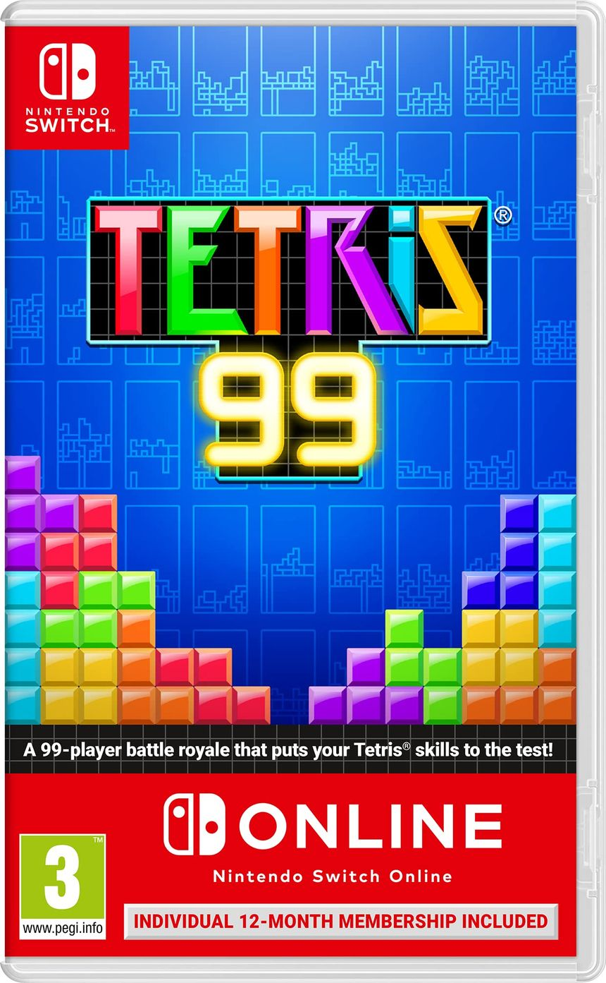

puzzle games
Puzzle games are a genre of video games that challenge players with logic, problem-solving, and pattern recognition. These games often require players to think critically and strategically to progress through levels or complete objectives. Here are some key features and popular examples:
Key Features:
Problem Solving: Players must find solutions to challenges, often involving patterns, sequences, or logical reasoning.
Variety of Mechanics: Puzzle games can include various mechanics, such as matching items, solving riddles, or navigating mazes.
Progressive Difficulty: Levels often increase in complexity, introducing new mechanics or obstacles as players advance.
Time Constraints: Some puzzle games add pressure by limiting the time available to complete challenges.

Slide 12
Puzzle games
Developer: Arika Other Works: Street Fighter(Game series)
Developer: Fireproof Games Other Works: The Room(Game series)
Players move and drop puzzle pieces called tetrominoes onto a playing board, and must clear rows by filling them completely with pieces. Spatial reasoning, problem solving skills, multiple strategy makes the game under the puzzle game genre.
The Room is a puzzle video game developed by Fireproof Games. The Room is a three-dimensional puzzle game. The game has a minimal story, in which the player is told by letters of a mysterious box in a room in a house. Problem solving, interactivity with objects, visual and environmental clues and the sense of discovery.

Slide 13






puzzle games
Types of Puzzle Games:
Match-3 Games: Players match three or more similar items to clear them from the board, often with colorful graphics.
Physics-Based Puzzles: Players manipulate objects in a physics-driven environment to solve challenges.
Logic Puzzles: These games focus on reasoning and deduction, often involving number puzzles or spatial challenges.
Word Puzzles: Players solve puzzles involving words, letters, or vocabulary.
Escape Room Games: Players solve a series of puzzles to escape from a locked room or complete a narrative.
Block and Tile Games: Players manipulate blocks or tiles to create lines, shapes, or patterns.

Slide 14

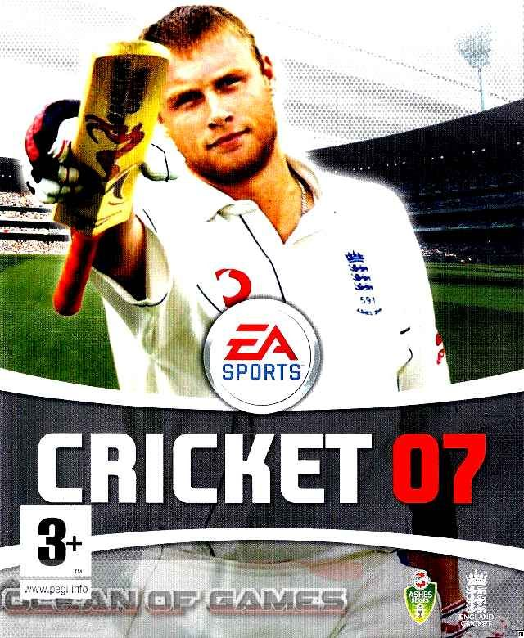
sports games
Sports games are video games that let players experience real or fictional sports. They come in many forms, from realistic simulations to fun, fast-paced arcade games. Here's a breakdown of the key features and types:
Key Features of Sports Games:
Realism: Many sports games try to be as realistic as possible, using real teams, athletes, and rules (like FIFA and NBA 2K).
Gameplay: The game usually focuses on controlling athletes to score goals, win matches, or complete races.
Game Modes:
Single-player, multiplayer, and career modes where you can play matches or manage teams.
Online and local multiplayer for playing with friends.
Customization: Players can create or modify teams, athletes, and uniforms.
Progression: Some games let you improve your players’ skills as you advance.

Slide 15
sports games
Developer: EA Vancouver,EA Romania Other Works: FIFA(Game series)
Developer: EA Canada,HB Studios Other Works: FIFA(Game series),NHL FIFA(Game series)
FIFA 22 is a football simulation video game published by Electronic Arts introduces "HyperMotion Technology,” (you have to score a power shot to see it) which uses motion capture data. Realistic Football Simulation, Competitive Play, Player and Team Management, Career Mode and Sports Game Mechanics brings the game under sports genre.
Cricket 07 is a 2006 cricket simulation computer game developed by EA Canada.Cricket 07 features limited overs matches (50, 20, 10 or 5 overs), 4-day first-class matches and full-length test matches (5 days). Realistic Gameplay, Sport-Specific Skills, Goal-Oriented play and Competitive Skills brings the game under sports genre.

Slide 16



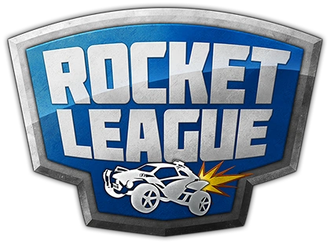



sports games
Types of Sports Games:
Team Sports Games:
Games where you control a full team, focusing on strategies and teamwork.
Individual Sports Games:
Focus on solo sports like tennis, golf, or boxing.
Racing Games:
Racing in cars, bikes, or other vehicles.
Arcade-style Sports Games:
Fast and exaggerated versions of sports, focusing on fun over realism.
Extreme Sports Games:
Focus on skateboarding, snowboarding, and other extreme activities.
Management Games:
You manage teams and make strategic decisions rather than playing the sport directly.
Fantasy/Fictional Sports Games:
These games create made-up or fantasy sports with unique rules.

Slide 17
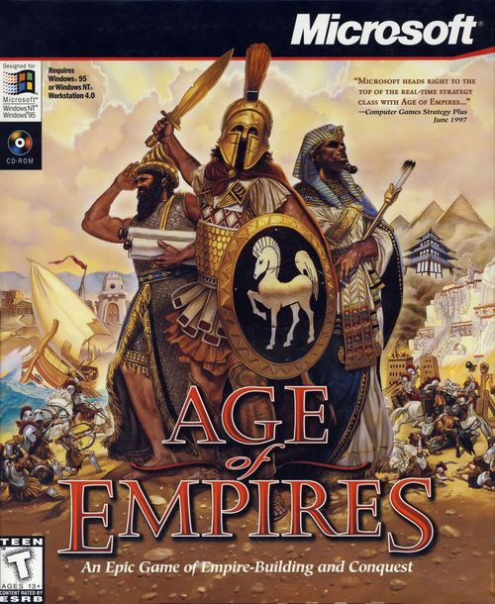
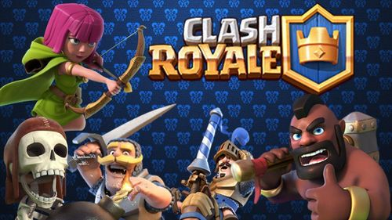
Strategy games
Strategy games are a genre of video games that is played careful planning, tactical decision-making, and resource management to achieve victory. Strategy games require players to think several steps ahead, manage resources, and execute long-term plans to win opponents or solve complex problems. Strategy games can be turn-based, where players take turns making moves, or real-time, where actions unfold continuously.
Key Features of Strategy Games:
Resource Management: Players must manage resources (such as currency, food, or energy) to build structures, recruit units, and advance technology.
Tactical Combat: Players often control armies, fleets, or units in combat. Strategy games require players to think about positioning, terrain, unit strengths and weaknesses, and timing when executing attacks.
Long-term Planning: Success in strategy games often comes from thinking ahead. Players must make decisions that will affect future turns, matches, or phases of the game.
Decision Trees: Players usually face multiple choices that can branch into various outcomes. Decisions can be based on unit movements, upgrades, building types, alliances, or combat tactics, often leading to different strategies and end results.
Victory Conditions: Strategy games have different ways to win, such as conquering enemies, achieving economic dominance, completing a tech tree, or fulfilling specific objectives like capturing key locations.

Slide 18
strategy games
Developer: Ensemble Studios Other Works: Age of Empires(Game series)
Developer: Supercell Other Works: Clash of Clans
Age of Empires (AoE) is a real-time strategy video game based on history, allows the user to act as the leader of an ancient civilization by advancing it through four ages, gaining access to new and improved units. Resource Management, Base Building, Controlling unit and combat, Strategic Planning, Multiplayer and Competitive Mode brings the game under strategy genre.
Clash Royale is a real-time multiplayer game starring the Royales. Collect and upgrade dozens of cards featuring the Clash of Clans troops, spells and defenses you know.
Resource Management, Base Building, Controlling unit and combat, Strategic Planning, Multiplayer and Competitive Mode brings the game under strategy genre.

Slide 19






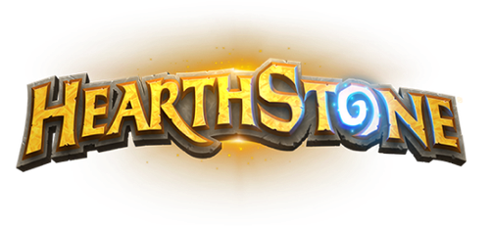
strategy games
Types of Strategy Games:
Turn-Based Strategy (TBS): Players take turns to move units, build structures, or make decisions. This format allows for thoughtful planning and gives players time to evaluate their next move.
Real-Time Strategy (RTS): Actions unfold in real time, requiring players to make quick decisions while managing resources, building units, and directing armies. Speed and adaptability are essential.
4X Strategy (Explore, Expand, Exploit, Exterminate): 4X games focus on managing an empire by exploring the game world, expanding territories, exploiting resources, and exterminating enemies. Tactical Strategy Games: Tactical strategy focuses on smaller-scale, turn-based combat. Players control a limited number of units or characters in combat, where every move is critical.
4.Tactical Strategy Games: Tactical strategy focuses on smaller-scale, turn-based combat. Players control a limited number of units or characters in combat, where every move is critical.
5.Tower Defense Games: Players must defend a base or territory by placing defensive structures that automatically attack waves of incoming enemies. Strategy involves selecting the right towers, upgrading them, and positioning them in optimal locations.
6.Card-Based Strategy: These games use collectible or customizable decks of cards to represent units, spells, or abilities. Players strategically play cards to defeat opponents, relying on deck-building and resource management.
7.Card-Based Strategy: These games use collectible or customizable decks of cards to represent units, spells, or abilities. Players strategically play cards to defeat opponents, relying on deck-building and resource management.

Slide 20
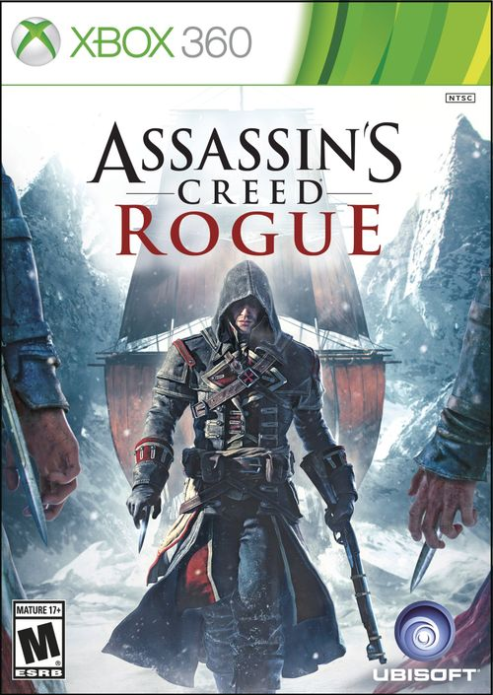

Stealth games
Stealth games are a subgenre of action games that emphasize avoiding detection, sneaking, and using tactics over brute force. In stealth games, players typically need to navigate through environments without being noticed by enemies or security systems, often achieving objectives such as assassinations, thefts, or espionage in a quiet and calculated manner.
Key Features of Stealth Games:
Avoiding Detection: A core aspect of stealth games is remaining undetected by enemies or surveillance systems.
Use of Shadows and Cover: Shadows, walls, and other environmental elements play a major role in stealth games, as they offer players places to hide and avoid detection.
Non-lethal and Lethal Options: Players are often given the choice to neutralize enemies in non-lethal ways (knocking out or tranquilizing enemies) or take more aggressive, lethal actions (killing them). Planning and Timing: Players must often observe enemy patrols and behaviors, waiting for the right time to move or strike. Stealth games often reward planning, patience, and careful timing rather than rushing in headfirst.
Disguises and Deception: In some stealth games, players can use disguises or gadgets to blend in with enemies, sabotage security systems, or otherwise trick adversaries into believing they are not a threat.
Noise Management: Stealth games often introduce sound as a factor. Players need to be aware of how much noise they make while moving or interacting with the environment (e.g., running vs. walking), as enemies can hear suspicious sounds and investigate.
Gadgets and Tools: Stealth games frequently provide players with a range of gadgets or tools that help them navigate the environment without being seen or to disable enemies silently. These can include smoke bombs, night vision goggles, tranquilizer guns, hacking devices, and more.

Slide 21
stealth games
Developer: Ubisoft Sofia Other Works: Assassins Creed(Game series)
Developer: Ubisoft Montreal Other Works: Clash of Clans
Assassin's Creed Rogue is a 2014 action-adventure-stealth game developed by Ubisoft .It is set between 2012's Assassin's Creed III and 2013's Assassin's Creed IV: Black Flag.
The Stealth Mechanics, Environmental interaction, Tactical Gameplay and variety of stealth based tools and gadget brings the game under stealth genre.
Bad Blood takes place one year after the events of the main story of Watch Dogs, and spans 10 new missions in new locations across Chicago. Players take control T-Bone, who infiltrates one of Blume's facilities in Chicago.
Stealth bases gameplay mechanism, hacking ability, parkour, focus on hacking and tools and gadgets for stealth assassination brings the game under stealth genre.

Slide 22





stealth games
Types of Stealth Games:
Pure Stealth Games: These games focus almost entirely on sneaking and avoiding detection. Players are penalized for being caught and often need to restart sections if they are spotted.
Action-Stealth Games: These games blend stealth mechanics with action-oriented gameplay, giving players the option to engage enemies directly if they are detected or if they choose to do so.
Open-World Stealth Games: Some stealth games are set in open worlds, giving players the freedom to approach objectives using stealth in a variety of ways, including blending into crowds, using vantage points, and planning routes.
Stealth Horror: These games incorporate stealth elements into horror settings, where players must hide from or avoid deadly creatures or enemies. Often, combat is not an option, and the focus is on survival through stealth.
Stealth-Adventure Games: These games combine stealth mechanics with adventure, puzzle-solving, and exploration. Players must sneak through levels while also solving environmental puzzles and progressing through the story.

Slide 23

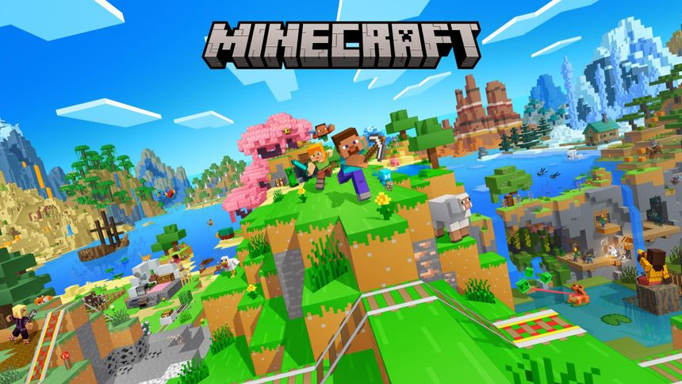
Sandbox games
Sandbox games are a genre of video games that provide players with a vast open world and give them the freedom to explore, create, and interact with the environment in any way they choose. Players are encouraged to experiment, explore, and create their own experiences within the game world.
Key Features of Sandbox Games:
Open-World Exploration: One of the defining features of sandbox games is the open-world environment, where players can explore vast landscapes, cities, or other settings with minimal restrictions.
Player Freedom: Players are given significant freedom to approach tasks, missions, or goals in the way they see fit.
Creative Gameplay: Sandbox games often include crafting, building, or customization elements. Players can use in-game tools or resources to build structures, modify the environment.
Dynamic World: The game world in sandbox games is often designed to be dynamic and reactive, meaning that player actions can influence or change the environment. For example, NPCs (non-player characters) may react to player behavior, weather may change, and environments can be destructible or modifiable.
Non-linear Storytelling: While some sandbox games feature a main story or campaign, they often allow players to pursue side quests, random encounters, or other activities at any time.
Modding and Customization: Many sandbox games support modding, where players can create custom content such as new missions, environments, or gameplay mechanics.

Slide 24
sandbox games
Developer: Mojang Studios Other Works: Minecraft(Game series)
Developer: IO Interactive Other Works: Hitman (Game series)
Minecraft is a 2011 sandbox game developed and published by Swedish video game developer Mojang Studios. In Minecraft, players can discover and extract raw materials, craft tools and items, and build structures, earthworks, and machines. The open world, creativity, building, resource management, modding and customization bring the game under the sandbox genre.
Hitman 3 is the eighth main installment in the Hitman video game series, the sequel to 2018's Hitman 2, and the third game in the World of Assassination trilogy. Hitman 3 is considered a sandbox game due to its design philosophy and gameplay mechanics that emphasize player choice, exploration, and freedom in how to approach objectives.

Slide 25
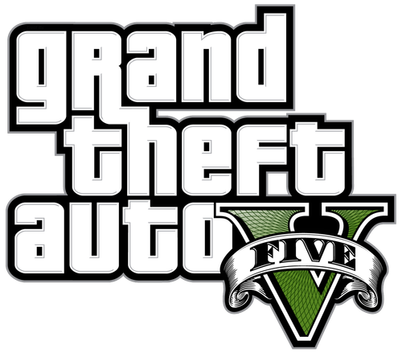


sandbox games
Types of Sandbox Games:
Survival Sandbox Games: These games combine open-world exploration with survival mechanics, where players must gather resources, craft tools, and build shelters to survive against environmental threats, hunger, or enemies.
Creative Building Sandbox Games: These games focus primarily on building and creativity, offering players a wide range of tools to create structures, worlds, or other content.
Action-Adventure Sandbox Games: These games feature large open worlds filled with activities, missions, and objectives but give players the freedom to complete them in any order.
Simulation Sandbox Games: Simulation sandbox games let players simulate systems or worlds, giving them control over various aspects of the environment or society.
Multiplayer Sandbox Games: Many sandbox games feature online multiplayer, where players can collaborate or compete in shared worlds.
Physics-Based Sandbox Games: These games revolve around manipulating objects, environments, and systems governed by realistic or exaggerated physics. The fun often comes from experimenting with how the game’s physics systems react to player input.

Slide 26
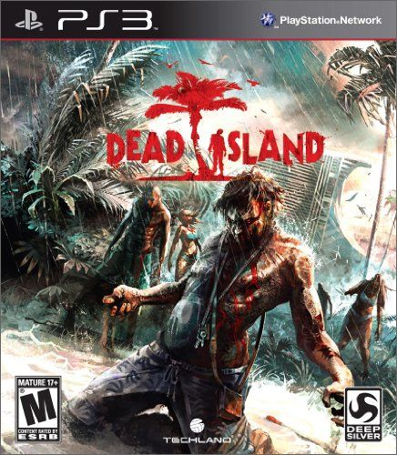
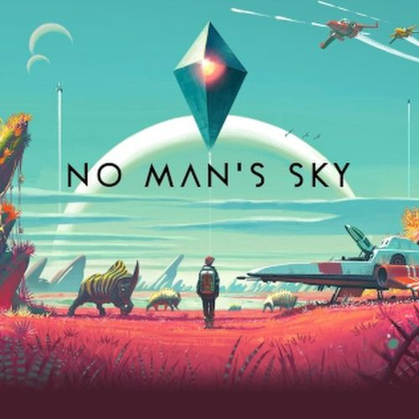
Survival games
Survival games are a genre where the player’s primary objective is to survive in a hostile environment by managing resources, crafting tools, and fending off threats such as hunger, predators, or other players. These games often involve open-world exploration, and the player must adapt to changing conditions, discover resources, and interact with dynamic environments to stay alive.
Key Features of Survival Games:
Resource Gathering: Survival games revolve around gathering essential resources like food, water, wood, and minerals.
Crafting and Building: Crafting is a core mechanic, where players use collected resources to create tools, weapons, and structures.
Health and Survival Mechanics: Players must manage various survival aspects like health, hunger, thirst, stamina, and sometimes mental stability
Exploration: Survival games often feature vast, open worlds for players to explore. These environments can range from post-apocalyptic wastelands to lush forests, deserted islands, or outer space.
Hostile Environments and Threats: Survival games often feature hostile environments filled with predators, enemies, or environmental hazards like extreme weather, radiation, or poisonous plants.
Consequences for Failure: Many survival games incorporate to severe consequences for dying, making survival more intense. If players die, they may lose all progress or resources and need to start from scratch, creating high stakes.
Limited Resources: Resources can be finite or become increasingly difficult to find, forcing players to strategize about how to use them effectively.
Day-Night Cycles and Environmental Changes: Many survival games feature a dynamic day-night cycle and changing weather.

Slide 27
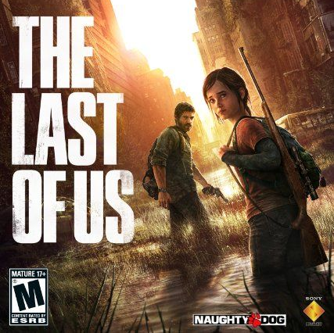
survival games
Developer: Naughty Dog Other Works: Uncharted (Game series)
Developer: Tech Land Other Works: Joe Danger (Game series)
The Last of Us is a 2013 action-adventure game developed by Naughty Dog and published by Sony Computer Entertainment. Players control Joel, a smuggler tasked with escorting a teenage girl, Ellie, across a post-apocalyptic United States. The last of us is a survival game due to its resource management, environmental threats, stealth, strategy, emotional story line and crafting
Dead Island is the game is centered on the challenge of surviving a zombie-infested open world with an important emphasis on melee combat. The plot focuses on four playable survivors trying to survive on the fictional island of Banoi. Dead island is a survival game due to its resource management, zombie threats, crafting weapons, survival storyline and open-world.

Slide 28



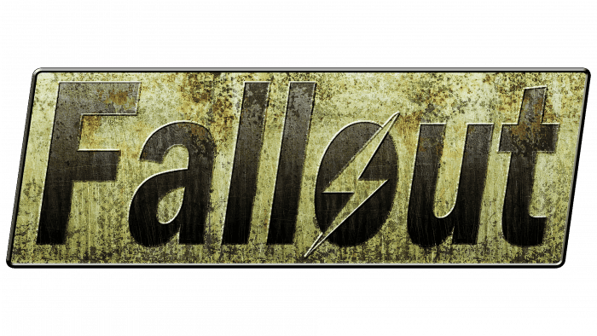


survival games
Types of Survival Games:
Open-World Survival: These games are set in large, often procedurally generated worlds that players can explore at their own pace. The emphasis is on crafting, base-building, and resource management.
Survival Horror: These games combine survival mechanics with horror elements, such as limited resources, terrifying enemies, and the constant threat of danger. The focus is often on survival in a psychologically intense environment.
Multiplayer Survival: Multiplayer survival games emphasize teamwork or competition, where players work together or against each other to survive in hostile environments. These games often blend cooperative play with PvP mechanics.
Post-Apocalyptic Survival: These games are set in post-apocalyptic worlds where players must survive after a catastrophic event like a nuclear fallout, zombie outbreak, or global disaster.
Survival Simulation: These games take a more realistic approach to survival, emphasizing real-world survival mechanics such as managing food, water, shelter, and health in realistic environments.
Space Survival: These games take survival into space or other planets, adding the challenges of space exploration, oxygen management, and technological crafting.

Slide 29
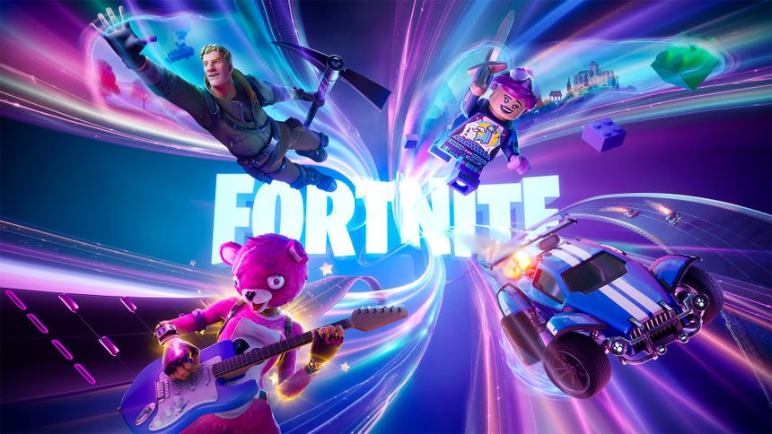

Battle royale games
Battle Royale games are a subgenre of multiplayer video games that blend elements of survival, exploration, and scavenging into a competitive format. In these games, a large number of players are dropped into a shrinking play area, where they must compete against each other to be the last player or team standing.
Key Features of Battle Royale Games:
Large Player Count: Battle Royale games typically feature a significant number of players, often ranging from 50 to 100 or more.
Shrinking Play Area: As the match progresses, the playable area gradually shrinks, forcing players into closer proximity and encouraging encounters.
Looting and Resource Management: Players start with minimal gear and must scavenge for weapons, armor, health items, and other resources scattered throughout the map.
Permadeath: Once a player is eliminated, they cannot respawn in that match, which adds a layer of intensity.
Solo, Duo, and Squad Modes: Most battle royale games offer different modes for players to choose from, such as solo (everyone for themselves), duo (teams of two), or squad (teams of four or more). This flexibility allows players to engage in matches with friends or solo.
In-Game Events and Dynamic Environments: Many battle royale games include dynamic events, such as supply drops, environmental hazards, or unique game mechanics that can change the flow of a match, creating more opportunities for players to engage or escape.
Cosmetics and Customization: Players often have the option to customize their characters with various cosmetic items, including skins, outfits, and emotes. This adds a personal touch to player identities within the game.

Slide 30
Battle royal games
Developer: Epic Games Other Works: Rocket Racing
Developer: Embark Studios Other Works: Arc Raiders(Upcoming)
Fortnite is an online video game and game platform developed by Epic Games. Fortnite Battle Royale, a free-to-play battle royale game in which up to 100 players fight to be the last person standing.
Fortnite is a battle royale game due to its large-scale multiplayer matches, survival-based, shrinking play area, free-for-all and scavenging of resources.
The Finals is a free-to-play first-person shooter, developed and published by Embark Studios. The game focuses on team-based matches on maps with a destructible environment, where players are encouraged to use the dynamic environment to their advantage. The Finals is a battle royale game due to its elimination-based game, dynamic area, shrinking play areas, resource equipment managment

Slide 31

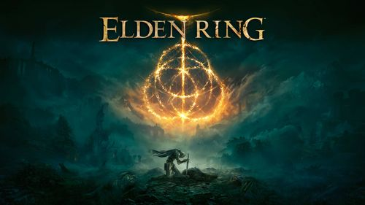
Role play games
Role-Playing Games (RPGs) are a genre of video games where players assume the roles of characters in a fictional setting. RPGs often emphasize storytelling, character development, and world-building, allowing players to immerse themselves in a narrative while making choices that affect the game's outcome.
Key Features of Role-Playing Games:
Character Creation and Development: Players often create their characters, selecting attributes, skills, and appearance.
Narrative and Storytelling: RPGs often feature rich narratives and well-developed worlds.
Quests and Objectives: Players typically undertake various quests, which can range from main story missions to side quests.
Combat Systems: RPGs feature diverse combat mechanics, from turn-based systems to real-time action.
Exploration: RPGs often feature vast, open worlds filled with secrets, hidden areas, and lore.
Progression Systems: Character progression is fundamental in RPGs, with players earning experience points to level up and improve their abilities.
Inventory and Equipment Management: Players typically manage an inventory of items, weapons, and armor.
Social Interactions: Many RPGs incorporate social mechanics, allowing players to interact with NPCs or other players.

Slide 32
Role play games
Developer: CD Projekt Red Other Works: Witcher (Game Series)
Developer: From Software Other Works: Dark Souls(Game Series)
The Witcher 3: Wild Hunt is action role-playing game developed and published by the Polish studio CD Projekt. The Witcher 2: Assassins of Kings and the third game in The Witcher video game series, played in an open world with a third-person perspective. The Witcher 3 is a role play game due to its character development,story line,immersive world, resource management and crafting.
Elden Ring is an action role-playing game developed by FromSoftware. The game is set in the Lands Between, players control a customizable player character on a quest to repair the Elden Ring and become the new Elden Lord. Elden Ring is a role play game due to its character customization, progression and leveling system, storytelling, exploration of a massive world, fantasy world and strategy.

Slide 33




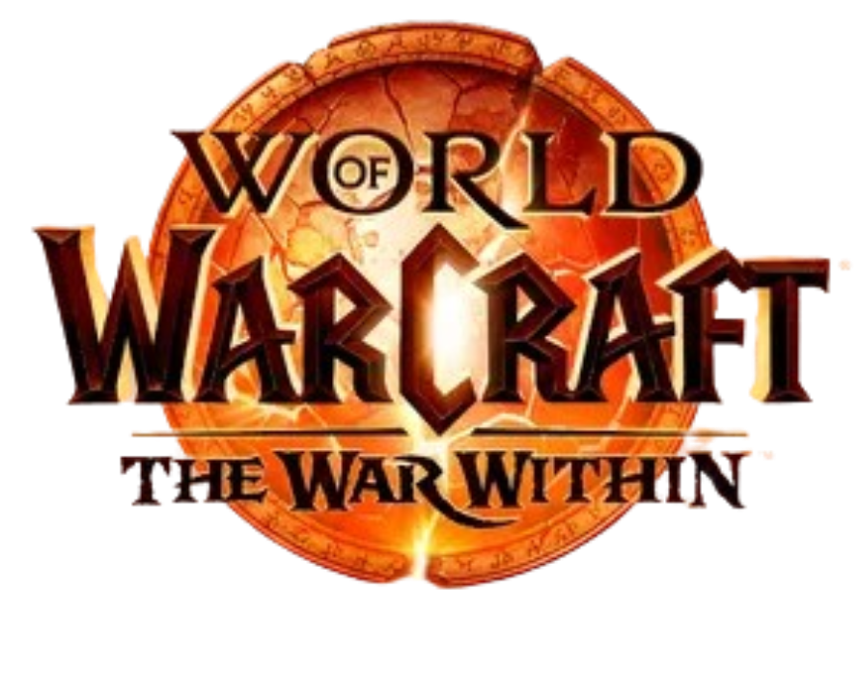



role play games
Types of Role-Playing Games:
Traditional Turn-Based RPGs: These games feature turn-based combat where players and enemies take turns to act.
Action RPGs: These games emphasize real-time combat and often feature fast-paced gameplay.
Western RPGs (WRPGs): Typically developed by Western studios, these RPGs often emphasize player choice and open-world exploration.
Japanese RPGs (JRPGs): These RPGs often feature turn-based combat, linear storytelling, and strong character-driven narratives.
Massively Multiplayer Online Role-Playing Games (MMORPGs): MMORPGs allow thousands of players to interact in a persistent online world. Players complete quests, participate in raids, and engage in PvP combat while developing their characters.
Tactical RPGs (TRPGs): These games focus on strategic, grid-based combat, often emphasizing character positioning and tactical planning.
Roguelike RPGs: Players often build characters with unique abilities and explore randomly generated dungeons.
Text-Based RPGs: These games rely heavily on text for storytelling and gameplay. Players make choices that affect the outcome of the narrative, often without graphics or real-time combat.

Slide 34
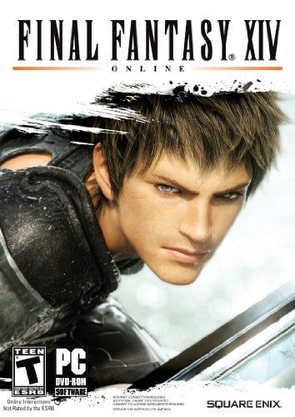
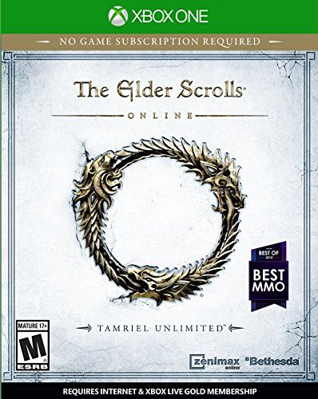
Mmorpg games
Massively Multiplayer Online Role-Playing Games (MMORPGs) are a subgenre of role-playing games that allow thousands of players to interact in a persistent online world. Players create characters, embark on quests, engage in combat, and interact with other players in a vast, often richly detailed environment
Key Features of MMORPGs:
Persistent World: MMORPGs feature a game world that continues to evolve even when the player is offline.
Character Creation and Customization: Players typically have extensive options for creating and customizing their characters, including choosing races, classes, abilities, and appearance.
Questing and Storylines: MMORPGs often feature rich narratives and numerous quests that players can undertake.
Social Interaction: Players can interact with each other through chat, trade, and cooperative gameplay.
Leveling and Progression: Characters in MMORPGs gain experience points (XP) by completing quests, defeating enemies, or participating in events.
Combat and Skill Systems: Many MMORPGs have combat systems that involve skill rotations, positioning, and teamwork. Players often learn and develop their characters' abilities over time.
Economy and Trading: Many MMORPGs feature in-game economies where players can buy, sell, and trade items.
Events and Updates: Developers regularly introduce events, expansions, and updates to keep the game fresh and engaging.

Slide 35
Mmorpg games
Developer: Bethesda Softworks Other Works: Elder Scrolls(Game Series)
Developer: Square Enix Other Works: Final Fantasy (Game Series)
The Elder Scrolls is a series of action role-playing video games primarily developed by Bethesda Game Studios and published by Bethesda Softworks. The series focuses on free-form gameplay in an open world The Elder Scrolls V: Skyrim (2011) all winning Game of the Year awards from multiple outlets. The Elder Scrolls is a MMORPG game due to its massive multiplayer world, world exploration, character progression and dynamic content.
Final Fantasy XIV is a massively multiplayer online role-playing game (MMORPG) developed and published by Square Enix. Final Fantasy XIV is set in the fantasy region of Eorzea, five years after the devastating Seventh Umbral Calamity which ended the original version. This game is present in this genre due to its massive online world, role-play elements, social interaction, real-time combat and regular updates

Slide 36


casino games
Casino games are a popular genre of gambling games found in casinos, both physical and online. These games often involve betting money or chips with the hope of winning additional money based on chance, strategy, or a combination of both.
Key Features of Casino Games:
Betting : Most casino games require players to place a bet before they can participate. This can be in the form of money, chips, or other stakes, with potential payouts based on the outcome of the game.
Chance vs. Skill: Casino games can be categorized based on whether they rely more on chance (e.g., slot machines, roulette) or skill (e.g., poker, blackjack). Many games blend both elements, where skill can influence the outcome but chance plays a significant role.
Payouts : Each game has specific rules regarding how payouts are calculated based on the odds of winning. Understanding these odds can help players make informed betting decisions.
Game Variety: Casinos offer a wide range of games, catering to different preferences and styles. This includes table games, card games, slot machines, and specialty games.
Atmosphere and Experience: Physical casinos often create an immersive atmosphere with elaborate décor, lighting, and sound to enhance the gaming experience. Online casinos aim to replicate this atmosphere through graphics and user interfaces.
Social Interaction: Many casino games, especially table games, encourage social interaction among players.

Slide 37
casino games
Roulette (named after the French word meaning "little wheel") is a casino game which was likely developed from the Italian game Biribi. In the game, a player may choose to place a bet on a single number, various groupings of numbers, the color red or black, whether the number is odd or even, or if the number is high or low. Roulette is a casino game due to its random outcomes, betting structure, house edge, social and interactive appeal.
Blackjack (formerly black jack or vingt-un) is a casino banking game. It is the most widely played casino banking game in the world. It uses decks of 52 cards and descends from a global family of casino banking games known as "twenty-one".
Black Jack is a casino game due to its simple rules, strategy element, quick rounds, house edge and social and competitive levels.

Slide 38
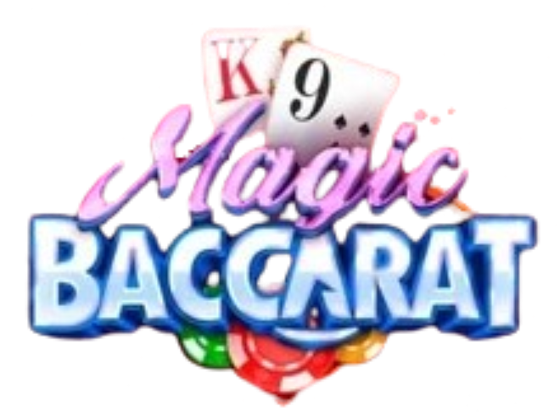
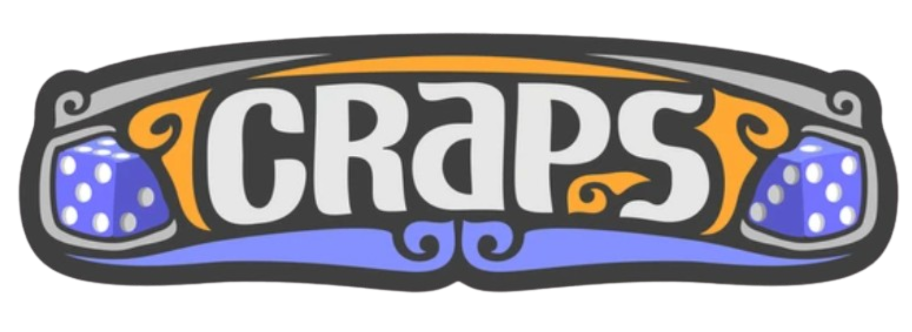
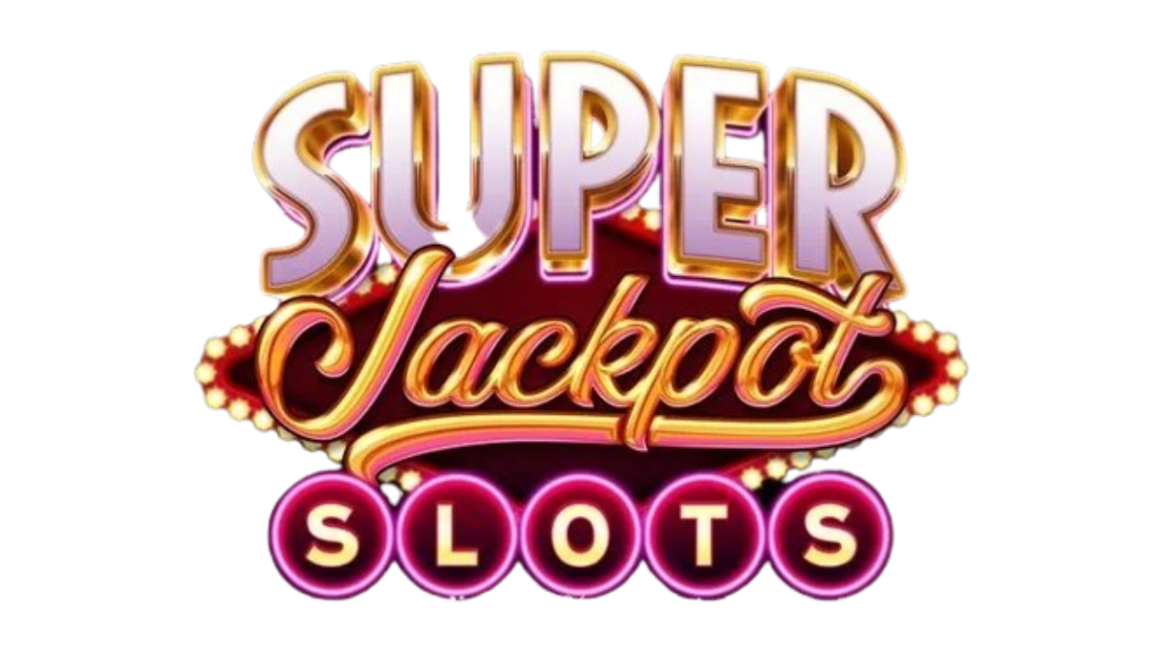

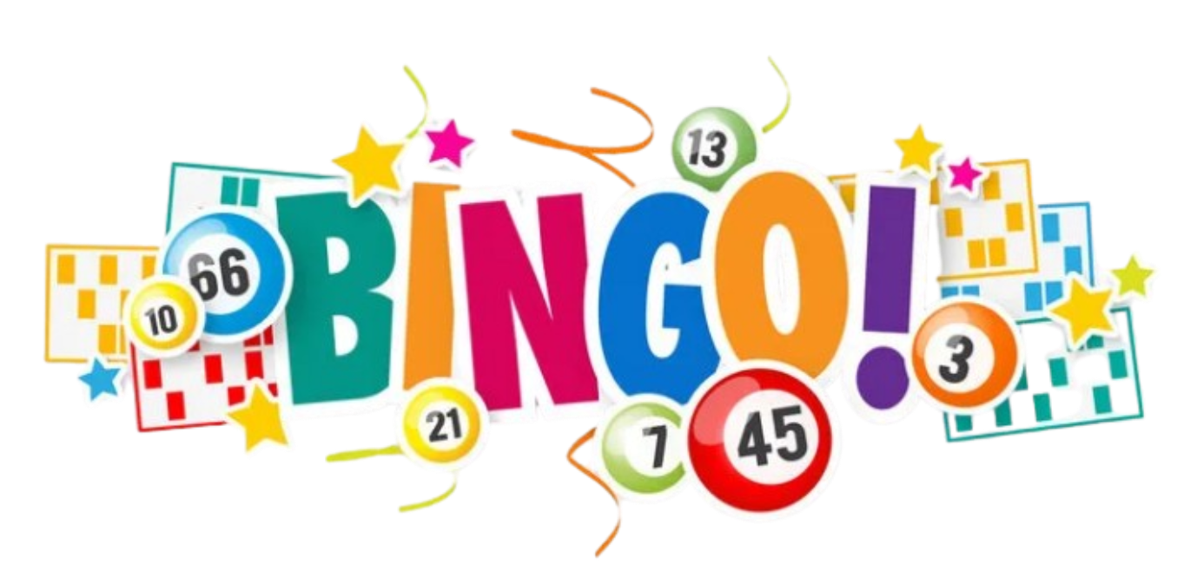
Casino games
Types of Casino Games:
Table Games:
Blackjack: A card game where players aim to have a hand value closer to 21 than the dealer without exceeding it.
Roulette: A game where players bet on where a ball will land on a spinning wheel, with various betting options based on numbers and colors.
Craps: A dice game where players bet on the outcome of the roll or a series of rolls.
Baccarat: A card game where players bet on the outcome of two hands (player and banker), trying to predict which will have a higher value.
Slot Machines: These are one of the most popular forms of casino gaming, featuring spinning reels with various symbols.
Poker: A popular card game with various variants where players compete against each other rather than the house.
Video Poker: A digital version of poker.
Live Dealer Games: Many online casinos offer live dealer games, where players can interact with real dealers via video streaming, providing a more authentic casino experience.

Slide 39
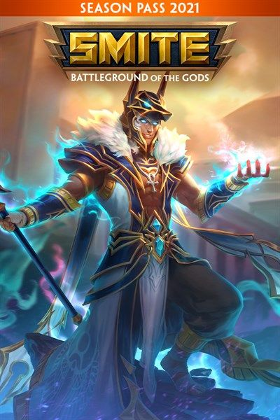
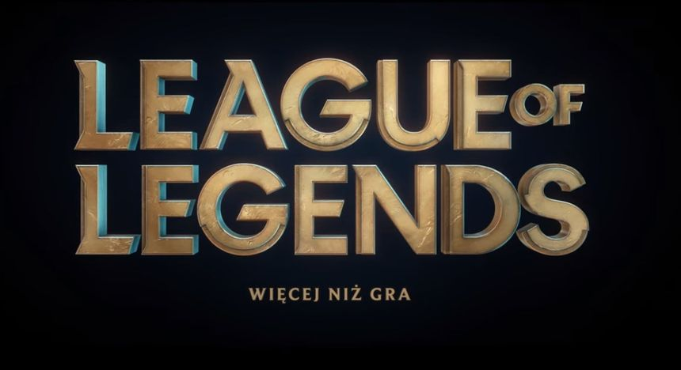
moba games
Multiplayer Online Battle Arena (MOBA) is a subgenre of real-time strategy games that emphasizes teamwork and competitive gameplay. In MOBAs, players control a single character with unique abilities and work together to defeat an opposing team by destroying their base or achieving specific objectives.
Key Features of MOBA Games:
Team-Based Gameplay: MOBA games typically involve two teams, often consisting of five players each, competing against one another.
Unique Characters (Heroes/Champions): Each player selects a unique character (often called a hero or champion) with distinct abilities, roles, and playstyles.
Lanes and Maps: Games are usually played on a symmetrical map divided into lanes and a jungle area. Players move along these lanes to engage enemies, farm minions, and destroy enemy structures.
Objective-Based Gameplay: In addition to defeating opponents, players must complete specific objectives, such as destroying towers, securing control points, or defeating powerful neutral monsters.
Experience and Gold Systems: Players earn experience points (XP) and gold by defeating enemies, farming minions, or completing objectives.
Strategic Depth: MOBA games require strategic thinking, including character selection, team composition, and decision-making regarding when to engage or retreat.
Skill-Based Combat: Players must use skill and precision to execute abilities effectively. Timing, positioning, and map awareness are crucial for success in battles.
Regular Updates and Balance Changes: Developers frequently update MOBAs to introduce new characters, items, and balance changes to encourage diverse gameplay.

Slide 40
Moba games
Developer: Riot Games Other Works: Valorant
Developer: Titan Forge Games Other Works: Paladins
League of Legends (LoL), commonly referred to as League, is a 2009 multiplayer online battle arena video game developed and published by Riot Games. League has been free-to-play and is purchasable character customization. League of Legends, due to its simple rules, strategy element, quick rounds, house edge and social and competitive levels. LOL is a MOBA game due to its team-based gameplay, map design, character roles, objectives and strategy and competitive nature.
Smite is a free-to-play, third-person multiplayer online battle arena (MOBA). In Smite, players control a god, goddess or other mythological figure and take part in team-based combat, using their abilities and tactics against other player-controlled gods and non-player-controlled minions. Smite is a MOBA game due to its team-based gameplay, character selection, objective –based matches, map design, team strategy and co-ordinations

Slide 41
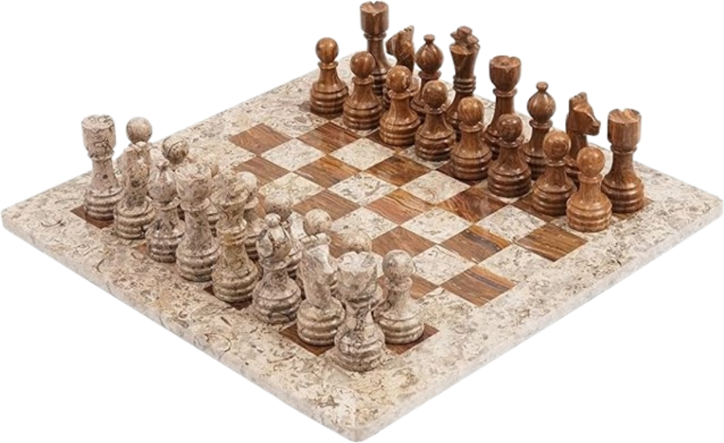
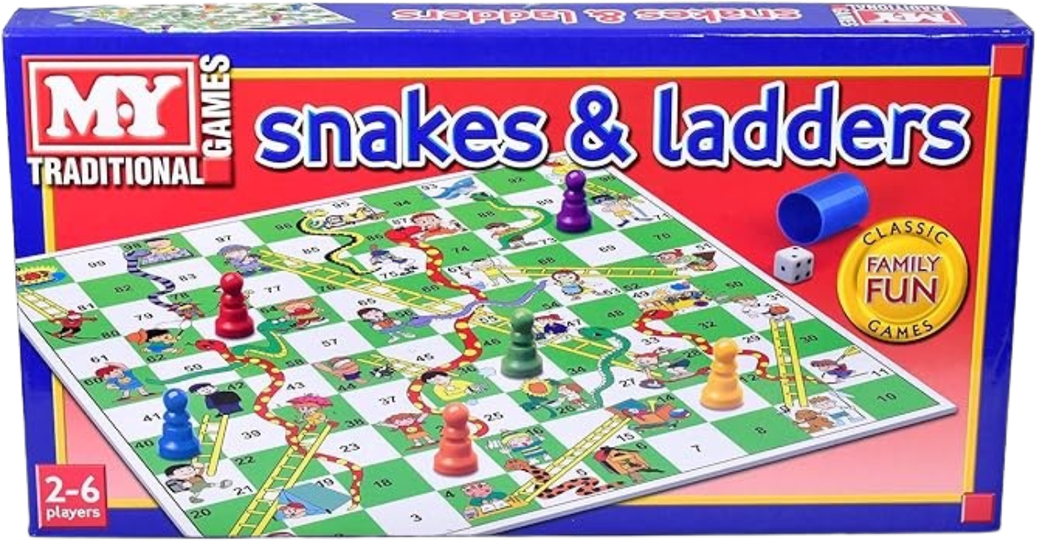
board games
Board games are tabletop games that involve the use of a board, pieces, and often cards or dice. They can be played by two or more players and typically require strategy, chance, or a combination of both.
Key Features of Board Games:
Game Board: Most board games feature a physical board that provides a playing surface.
Components: Board games typically include various components such as game pieces (tokens, pawns, or figurines), cards, dice, and player boards.
Rules and Objectives: Each board game has its own set of rules that outline how to play, win conditions, and the sequence of actions.
Player Interaction: Many board games require players to interact with each other through competition, negotiation, or cooperation.
Turn-Based Play: Most board games involve turn-based gameplay, where players take turns performing actions or making decisions.
Theme and Story: Many board games have specific themes or narratives, ranging from fantasy and adventure to historical and modern settings. The theme can enhance the overall experience and immersion.
Victory Conditions: Board games typically have defined victory conditions, which can vary widely, such as accumulating points, achieving specific objectives, or eliminating opponents.

Slide 42
board games
Chess is an abstract strategy game that involves no hidden information and no elements of chance. It is played on a chessboard with 64 squares arranged in an 8×8 grid. The players, referred to as "White" and "Black", each control sixteen pieces: one king, one queen, two rooks, two bishops, two knights, and eight pawns. White moves first, followed by Black. Chess is a board game due to its game board, physical components, turn-based play, strategic depth, rules and objectives
Snakes and ladders is a board game for two or more players regarded today as a worldwide classic. The game originated in ancient India as Moksha Patam, and was brought to the United Kingdom in the 1890s. It is played on a game board with numbered, gridded squares. A number of "ladders" and "snakes" are pictured on the board, each connecting two specific board squares. Snakes and ladders is a board game due to its game board, physical components, turn-based play, rules and objectives and social interactions

Slide 43






board games
Types of Board Games:
Strategy Games: Games that emphasize strategic planning and decision-making.
Party Games: Games designed for large groups, often focused on social interaction and entertainment.
Cooperative Games: Games where players work together to achieve a common goal, often against the game itself.
Abstract Games: Games that focus on strategy with minimal luck and thematic elements.
Thematic Games: Games that immerse players in a specific theme or story, often with detailed components and narratives.

Slide 44
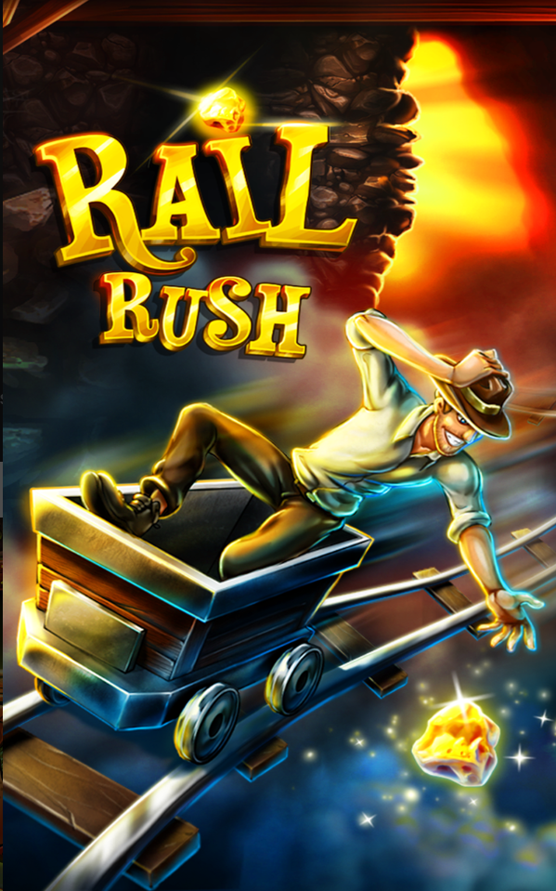
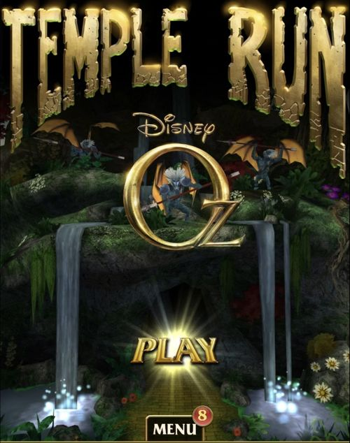
casual games
Casual games are a genre of video games designed to be easy to learn and play, appealing to a broad audience that includes players who may not consider themselves "gamers."
Key Features of Casual Games:
Easy to Learn: Casual games often have straightforward mechanics and minimal rules, allowing players to pick them up quickly without extensive tutorials.
Short Play Sessions: Many casual games are designed for brief gameplay sessions, making them ideal for players with limited time.
Accessible Graphics and Sound: Casual games often feature bright, colorful graphics and lighthearted soundtracks that enhance the gaming experience without overwhelming players.
Minimal Investment: These games often do not require a significant financial investment, with many being free-to-play or low-cost.
Variety of Genres: Casual games can span multiple genres, including puzzle, simulation, platformer, card games, and more.
Social Features: Many casual games incorporate social elements, such as leaderboards, challenges, and sharing capabilities, allowing players to connect with friends or compete against others.
Addictive Gameplay: Casual games often employ mechanics that encourage repeated play, such as daily challenges, rewards, or leveling systems, making them easy to return to over time.

Slide 45
casual games
Developer: Imangi Studios Other Works: Temple Run(game series)
Developer: Tango Gameworks Other Works: Paladins
Rail Rush is an endless runner game where you control a mining cart as it hurtles through a treacherous railroad track. Your goal is to collect precious stones, gems, and golden nuggets while avoiding obstacles and staying on the rails for as long as possible. Rail rush is a casual game due to its easy to understandable mechanics, engaging and competitive gameplay, appealing visuals and sound and progressive rewards
Temple Run: Oz is an endless runner game developed by Disney and Imangi Studios, inspired by the film Oz the Great and Powerful. The game is based on the events of the movie and combines elements from Temple Run 2. Temple Run: Oz is a Casual game due to its understandable mechanics, endless gameplay, visual appeals, competitive nature and rewards

Slide 46



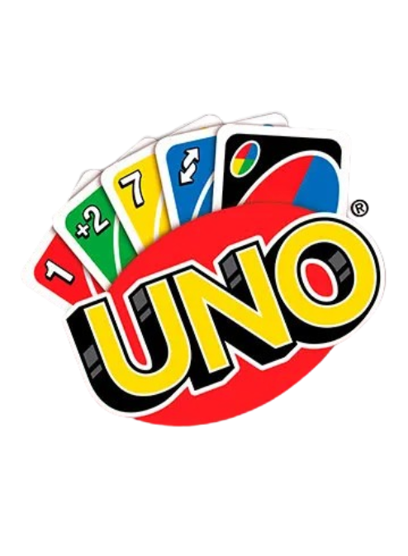

casual games
Types of Casual Games:
Puzzle Games: Games that challenge players to solve problems or complete tasks through logic, pattern recognition, or strategy..
Simulation Games: Games that simulate real-life activities, often with simplified mechanics.
Arcade and Action Games: Fast-paced games that focus on quick reflexes and simple controls.
Word Games: Games that involve creating or guessing words, often with a competitive element.
Card and Board Games: Digital adaptations of classic card and board games that are easy to play and often include social features.
Idle and Incremental Games: Games where players make decisions that lead to incremental progress over time, often with minimal direct input required during play.

Slide 47


Hyper casual games
Hyper-casual games are a subgenre of casual games characterized by their extremely simple mechanics, quick gameplay, and highly addictive nature. They are designed to be played in short bursts, often requiring minimal effort or time investment from the player.
Key Features of Hyper-Casual Games:
Simplicity: Hyper-casual games feature minimalistic design and mechanics that are easy to understand. Players can usually grasp the game rules within seconds.
Instant Gameplay: Players can start playing immediately without extensive tutorials or complex menus. The emphasis is on quick access and minimal barriers to entry.
Short Sessions: Games are designed for very brief play sessions, often lasting just a few minutes. This makes them perfect for quick breaks or when players have limited time.
Addictive Mechanics: Many hyper-casual games employ addictive gameplay loops, encouraging players to keep coming back for "just one more try."
Minimal Graphics and Sound: The art style is often simplistic, focusing on bright colors and clear visuals.
Wide Audience Appeal: Due to their simplicity and accessibility, hyper-casual games attract a diverse range of players, including those who may not typically engage with traditional gaming.
Freemium Model: Many hyper-casual games are free to play, supported by in-app advertisements and optional in-game purchases.

Slide 48
Hyper casual games
Developer: .Gears Other Works: Flappy Birds Family
Developer: Nekki Other Works: Shadow Fight
Flappy Bird is a 2013 casual mobile game developed by Vietnamese video game artist .The game is a side-scroller where the player controls a bird, Faby, attempting to fly between columns of green pipes without hitting them. Flappy is a casual game due to its simple mechanics, short sessions, accessibility, addictive nature, mobile-friendly and minimalistic design
Vector is a 2012 side-scrolling platformer game developed and published by Cyprus-based studio Nekki for Windows, Android, and iOS. The objective of the game is to break free from the cycle as a free runner. Vector is a casual game due to its simple controls, short play sessions, engaging and competitive, visual appeal and progressive rewards

Slide 49
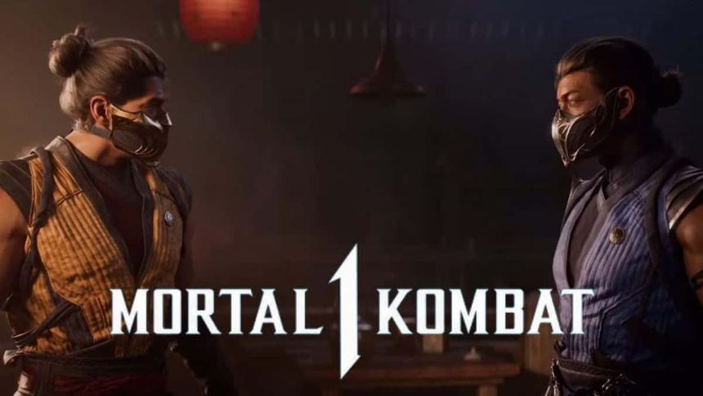
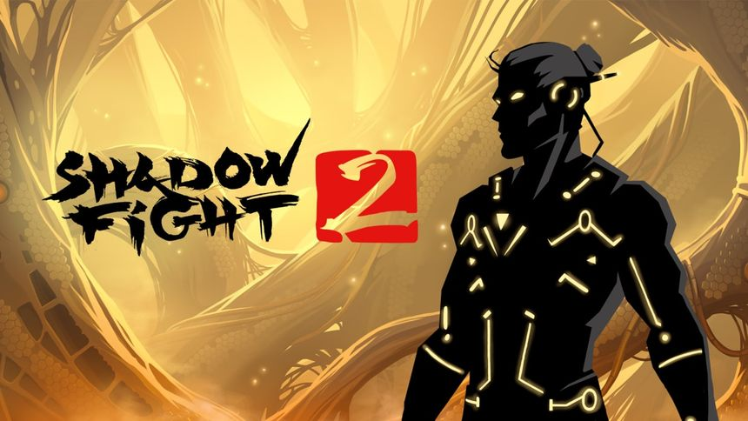
fighting games
Fighting games are a genre of video games that focus on close combat between a limited number of characters, often featuring one-on-one battles. These games emphasize player skill, reflexes, and strategic thinking, as players control characters with unique abilities and fighting styles to defeat their opponents.
Key Features of Fighting Games:
Character Selection: Players can choose from a roster of characters, each with distinct moves, abilities, and fighting styles.
Combat Mechanics: Fighting games typically feature a range of combat mechanics, including punches, kicks, throws, and special moves.
Health Bars: Each character has a health bar that depletes when they take damage.
Special Moves and Combos: Many fighting games include special moves that can be executed by inputting specific combinations of buttons.
Multiplayer and Competitive Play: Fighting games often feature multiplayer modes, allowing players to battle against friends or online opponents.
Stages and Environments: Battles typically take place in varied environments or stages, each with its own design and sometimes interactive elements that can affect gameplay.
Single-Player Modes: Many fighting games include single-player modes, such as story campaigns, arcade modes, or survival challenges, allowing players to explore narratives or practice their skills.

Slide 50
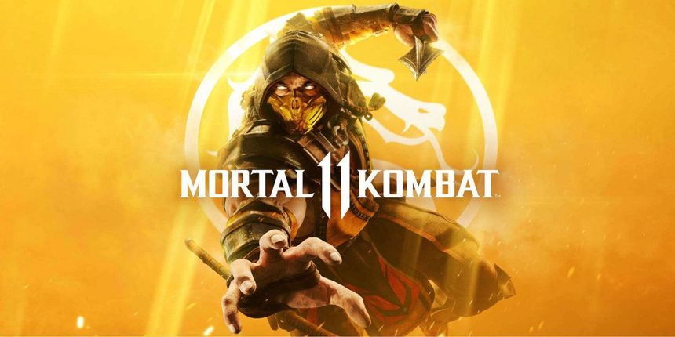
fighting games
Developer: Nekki Other Works: Shadow Fight(Game Series)
Developer: NetherRealm Studios Other Works: Mortal Kombat(Game Series)
Shadow Fight 2 is a role-playing fighting game published and developed by Nekki. The game uses the same graphics as Shadow Fight, which depict the player character and their opponents as 2D silhouettes. The game is more story-driven and follows a warrior known only as "Shadow", who fights to regain his lost honor and opening the Gates of Shadows. Shadow Fight 2 is a fighting game due to its combat mechanics, character variety, skill-based gameplay, visual style and game mods
Mortal Kombat 11 is a 2019 fighting game developed by NetherRealm Studios and published by Warner Bros. Interactive Entertainment. It is the eleventh main installment in the Mortal Kombat series and a sequel to Mortal Kombat X (2015). Mortal Kombat 11 is a fighting game due to its gameplay mechanics, character roster, competitive elements, combo systems, special moves and finishers, visual style and story mode

Slide 51

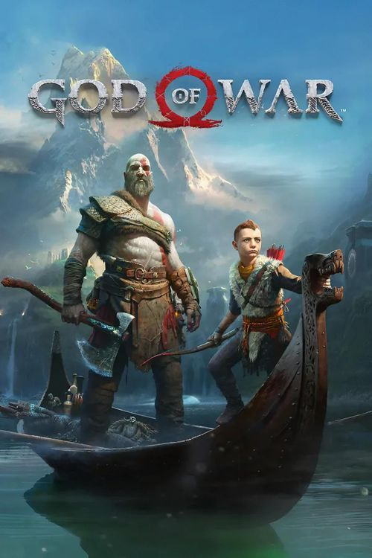
Action adventure games
Action-adventure games combine elements of action games and adventure games, focusing on both combat and exploration while incorporating narrative and puzzle-solving elements.
Key Features of Action-Adventure Games:
Combat Mechanics: Action-adventure games often feature real-time combat, allowing players to engage in battles with various enemies using melee weapons, firearms, or special abilities.
Exploration: Players explore expansive game worlds, often filled with secrets, collectibles, and side quests.
Puzzles and Challenges: Many action-adventure games include puzzles that require critical thinking to solve. These can range from environmental puzzles to logic-based challenges.
Narrative-Driven Gameplay: Action-adventure games typically feature rich narratives, with well-developed characters and story arcs that unfold throughout the game.
Character Development: Players often control a single protagonist whose abilities may evolve over time through leveling up or acquiring new skills and equipment.
Open or Semi-Open Worlds: Many action-adventure games feature open-world or semi-open world designs, allowing players to choose how they explore and progress through the game.
Inventory and Resource Management: Players often manage an inventory of items, weapons, or tools that can be used for combat, puzzle-solving, or exploration.

Slide 52
Action adventure games
Developer: Naughty Dogs Other Works: Uncharted (Game Series)
Developer: Santa Monica Studio Other Works: God of War (Game Series)
Uncharted 4: A Thief's End is a 2016 action-adventure game developed by Naughty Dog and published by Sony Computer Entertainment. It is the fourth main entry in the Uncharted series. Set several years after the events of Uncharted 3: Drake's Deception, players control Nathan Drake. Uncharted 4 is an action adventure game due to its narrative focus, exploration, puzzle solving, cinematic experience, character development and navigation
God of War is a 2018 action-adventure game developed by Santa Monica Studio and published by Sony Interactive Entertainment. It is the eighth installment in the God of War series, the eighth chronologically, and the sequel to 2010's God of War III. God of War is an action adventure game due to its action-based combat, exploration, puzzle solving, narrative, character development, open world elements, character progression and cinematic experience

Slide 53
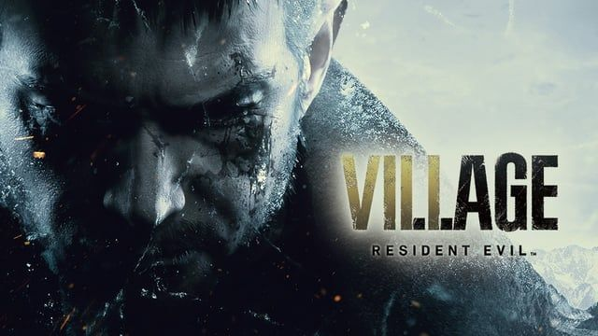

Survival horror games
Survival horror is a subgenre of video games that combines elements of survival games and horror, focusing on the player’s ability to survive in a terrifying environment filled with threats.
Key Features of Survival Horror Games:
Atmospheric Environments: Survival horror games often feature dark, eerie, and immersive environments that create a sense of dread. The use of lighting, sound design, and visual aesthetics contributes to the overall atmosphere.
Limited Resources: Players typically have restricted access to weapons, ammunition, health items, and other resources. This scarcity requires careful management and strategic decision-making.
Puzzles and Exploration: Many survival horror games include puzzles that must be solved to progress through the game. Exploration is crucial for finding items and uncovering the story, adding to the sense of discovery and tension.
Threats and Enemies: Players face various threats, including monsters, zombies, or other hostile entities. These enemies often possess unique behaviors and attack patterns, increasing the challenge and fear factor.
Psychological Elements: Survival horror games frequently delve into psychological horror, exploring themes of fear, isolation, and despair. This can manifest through unsettling narratives, character experiences, and environmental storytelling.
Survival Mechanics: Players must often make difficult choices to survive, such as deciding whether to fight or flee, which can lead to different outcomes. Resource scarcity and environmental dangers add to the survival aspect.

Slide 54
Survival horror games
Developer: Remedy Entertainment Other Works: Alan Wake 2
Developer: Capcom Other Works: Resident Evil (Game Series)
Resident Evil Village is a 2021 survival horror game developed and published by Capcom. It is the sequel to Resident Evil 7: Biohazard (2017) and the tenth main game of the Resident Evil series. Players control Ethan Winters, who searches for his kidnapped daughter in a village filled with mutant creatures. Village is a survival horror game due to its atmosphere setting, limited resources, enemies, puzzle solving, narrative themes, gameplay mechanics and immersive sound design
Alan Wake is a 2010 action-adventure game developed by Remedy Entertainment. The story follows bestselling crime thriller novelist Alan Wake as he tries to uncover the mystery behind his wife's disappearance during a vacation in the small fictional town of Bright Falls, Washington, all while experiencing events from the plot of his latest novel, which he cannot remember writing, coming to life. Alan Wake is a survival horror game due to its atmospheric setting, psychological horror, limited resources, combat mechanics and narrative focus

Slide 55
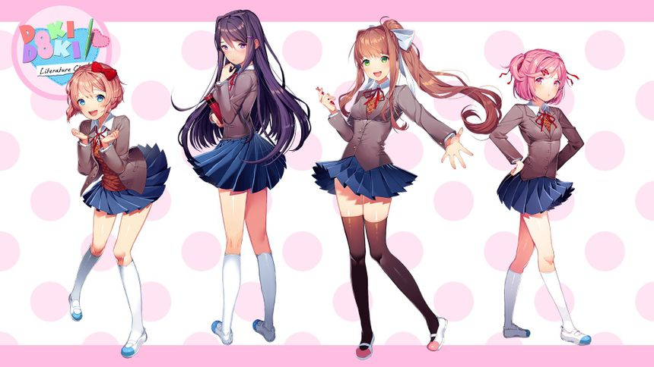
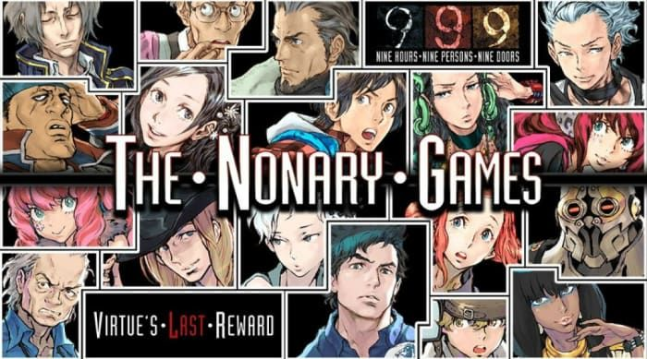
Visual novel games
Survival horror is a subgenre of video games that combines elements of survival games and horror, focusing on the player’s ability to survive in a terrifying environment filled with threats. These games emphasize atmospheric tension, resource management, and psychological horror, often creating a sense of fear and vulnerability as players navigate through challenging scenarios.
Key Features of Survival Horror Games:
Atmospheric Environments: Survival horror games often feature dark, eerie, and immersive environments that create a sense of dread..
Limited Resources: Players typically have restricted access to weapons, ammunition, health items, and other resources.
Puzzles and Exploration: Many survival horror games include puzzles that must be solved to progress through the game.
Threats and Enemies: Players face various threats, including monsters, zombies, or other hostile entities.
Psychological Elements: Survival horror games frequently delve into psychological horror, exploring themes of fear, isolation, and despair.
Survival Mechanics: Players must often make difficult choices to survive, such as deciding whether to fight or flee, which can lead to different outcomes.

Slide 56
Visual novel games
Developer: Team Salvato Other Works: Magicore Anomala
Developer: Spike Chunsoft Other Works: Dragon Quest(Game Series)
Doki Doki Literature Club! is a 2017 freeware visual novel developed by American independent game studio Team Salvato. The story follows a student who reluctantly joins his high school's literature club at the insistence of his friend Sayori, and is given the option to romantically pursue her. DDLC is a visual novel game due to its text-based storytelling, character development, branching paths, limited gameplay mechanics, art and presentation
Zero Escape, formerly released in Japan as Kyokugen Dasshutsu, is a series of adventure games.Each game in the series follows a group of nine individuals, who are kidnapped and held captive by a person code-named "Zero", and are forced to play a game of life and death to escape. This game is a visual novel game due to its narrative focus, dialogue- driven, character interaction, puzzle elements and multiple endings

Slide 57


education games
Educational games are designed to teach players specific skills, concepts, or knowledge while providing an engaging and interactive experience. They can cover a wide range of subjects, including mathematics, science, language arts, history, and more.
Key Features of Educational Games:
Learning Objectives: Educational games are designed with clear learning objectives in mind.
Engaging Gameplay: To maintain players' interest and motivation, educational games often incorporate engaging gameplay mechanics, challenges, and rewards.
Interactive Learning: Educational games encourage active participation, allowing players to interact with the material rather than passively receiving information.
Variety of Learning Styles: Educational games often cater to different learning styles (visual, auditory, kinesthetic) by incorporating various multimedia elements, such as visuals, sound, and interactive tasks.
Adaptability and Differentiation: Some educational games can be adapted to meet the needs of individual learners, allowing players to progress at their own pace or choose different paths based on their interests and skills.

Slide 58
education games
Web Sudoku is an online sudoku website which was rated as one of the best 50 fun and games website by Time. It was founded by Gideon Greenspan and Rachel Lee. The objective is to fill a 9 × 9 grid with digits so that each column, each row, and each of the nine 3 × 3 subgrids that compose the grid contains all of the digits from 1 to 9. Web Sudoku is an educational game due to its cognitive skill development, mathematical understanding, concentration and focus, flexible learning environment and playful engagement
Wordle is a web-based word game created and developed by Welsh software engineer Josh Wardle. Players have six attempts to guess a five-letter word, with feedback given for each guess in the form of colored tiles indicating when letters match or occupy the correct position. Wordle is an educational game due to its vocabulary development, spelling skills, critical think and strategy, pattern recognition, cognitive skills and social interaction

Slide 59

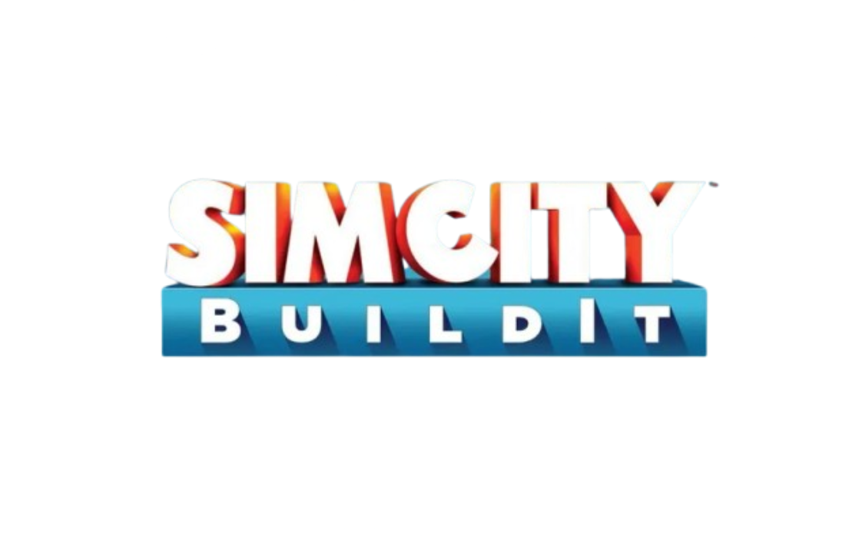



education games
Types of Educational Games:
Quiz and Trivia Games: Games that test players' knowledge on various topics through multiple-choice questions, fill-in-the-blank challenges, or other quiz formats.
Simulation Games: Games that mimic real-world processes or systems, allowing players to experiment and learn through simulation.
Puzzle Games: Games that challenge players to solve puzzles, often requiring critical thinking and problem-solving skills.
Language Learning Games: Games that focus on language acquisition and practice through vocabulary challenges, grammar exercises, and conversation simulations.
Math Games: Games that help players practice mathematical concepts, from basic arithmetic to advanced topics, in a fun and engaging way.
History and Social Studies Games: Games that explore historical events, cultures, and social issues, often allowing players to make decisions based on historical contexts.

Slide 60
THANK YOU

